Slide 1
LAB WORK: ARP POISIONING /SPOOFING

Slide 2
ARP Protocol
Address Resolution Protocol (ARP) is a protocol that enables network communications to reach a specific device on the network.
ARP translates Internet Protocol (IP) addresses to a Media Access Control (MAC) address, and vice versa.
Most commonly, devices use ARP to contact the router or gateway that enables them to connect to the Internet.
Hosts maintain an ARP cache, a mapping table between IP addresses and MAC addresses, and use it to connect to destinations on the network. If the host doesn’t know the MAC address for a certain IP address, it sends out an ARP request packet, asking other machines on the network for the matching MAC address.
The ARP protocol was not designed for security, so it does not verify that a response to an ARP request really comes from an authorized party. It also lets hosts accept ARP responses even if they never sent out a request.
This is a weak point in the ARP protocol, which opens the door to ARP spoofing attacks.
ARP only works with 32-bit IP addresses in the older IPv4 standard.
The newer IPv6 protocol uses a different protocol, Neighbor Discovery Protocol (NDP), which is secure and uses cryptographic keys to verify host identities. However, since most of the Internet still uses the older IPv4 protocol, ARP remains in wide use.

Slide 3
What Address Resolution Protocol (ARP) Works?
In a network, computers use the IP Address to communicate with other devices, however, in reality, the communication happens over the MAC Address.
ARP is used to find out the MAC Address of a particular device whose IP address is known.
For instance, a device wants to communicate with the other device on the network, then the sending device uses ARP to find the MAC Address of the device that it wants to communicate with.
ARP involves two steps to find the MAC address:
The sending device sends an ARP Request containing the IP Address of the device it wants to communicate with. This request is broadcasted meaning every device in the network will receive this but only the device with the intended IP address will respond.
After receiving the broadcast message, the device with the IP address equal to the IP address in the message will send an ARP Response containing its MAC Address to the sender.

Slide 4
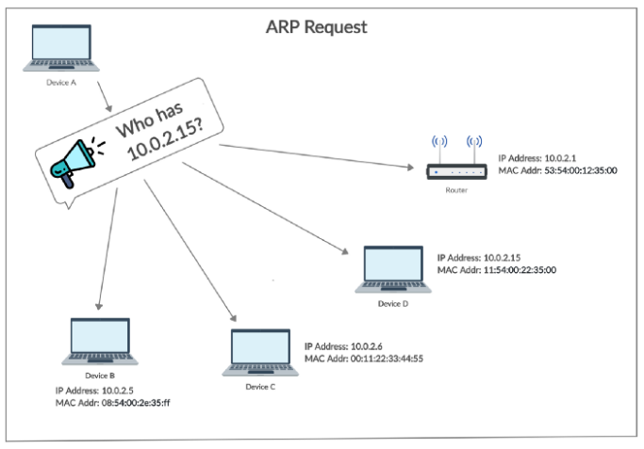
ARP REQUEST

Slide 5
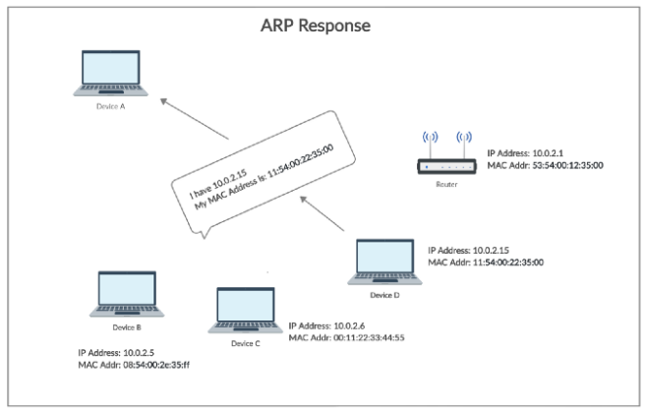
ARP RESPONSE

Slide 6
What is ARP Spoofing?
ARP spoofing is a Man In The Middle (MITM) attack in which the attacker (hacker) sends forged ARP Messages.
This allows the attacker to pretend as a legitimate user as it links the attacker machine’s MAC Address to the legitimate IP Address of the victim machine.
Once the MAC Address has been linked the attacker will now receive the messages intended for the legitimate IP Address(victim machine).
Furthermore, ARP Spoofing allows the attacker can intercept, modify, and drop the incoming messages.

Slide 7
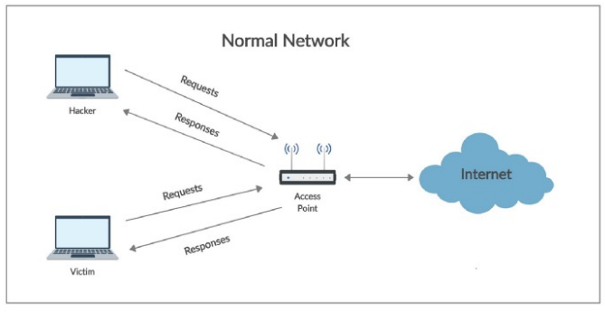
NORMAL NETWORK

Slide 8
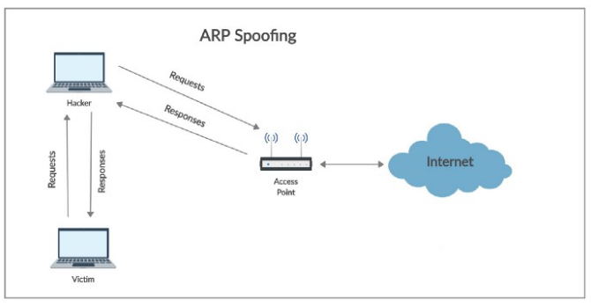
ARP SPOOFING

Slide 9
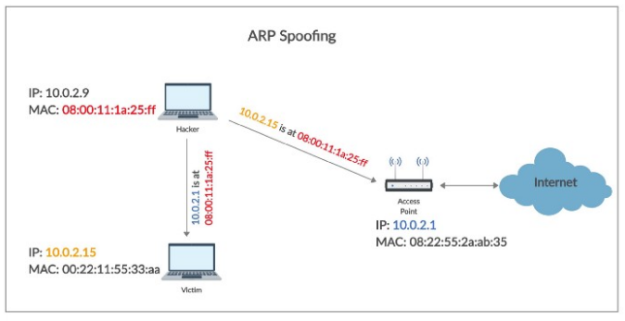
ARP SPOOFING
In ARP Spoofing, the hacker simply fools the access point and the victim by pretending as the access point in front of the victim and as the victim in front of the access point.

Slide 10
HOW TO EXECUTE ARP SPOOFING (ARP POISONING)
An ARP spoofing, also known as ARP poisoning, is a Man in the Middle (MitM) attack that allows attackers to intercept communication between network devices.
The attack works as follows:-
The attacker must have access to the network. They scan the network to determine the IP addresses of at least two devices⁠—let’s say these are a workstation and a router.
The attacker uses a spoofing tool, such as Ettercap, Arpspoof or Driftnet, to send out forged ARP responses.
The forged responses advertise that the correct MAC address for both IP addresses, belonging to the router and workstation, is the attacker’s MAC address. This fools both router and workstation to connect to the attacker’s machine, instead of to each other.
The two devices update their ARP cache entries and from that point onwards, communicate with the attacker instead of directly with each other.
The attacker is now secretly in the middle of all communications.

Slide 11
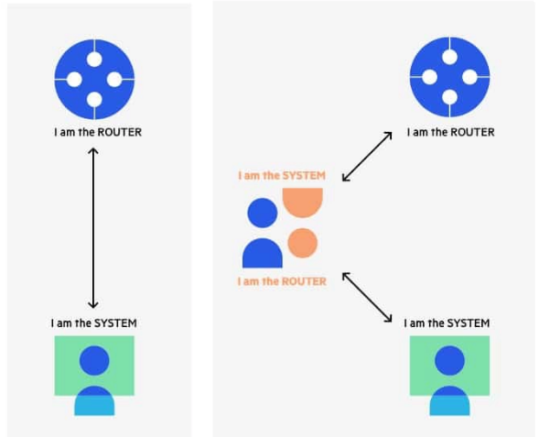
IP SPOOFING ATTACKER PRETENDS TO BE BOTH SIDES OF A NETWORK COMMUNICATION CHANNEL

Slide 12
Once the attacker succeeds in an ARP spoofing attack, they can:-
Continue routing the communications as-is⁠—the attacker can sniff the packets and steal data, except if it is transferred over an encrypted channel like HTTPS.
Perform session hijacking⁠—if the attacker obtains a session ID, they can gain access to accounts the user is currently logged into.
Alter communication⁠—for example pushing a malicious file or website to the workstation.
Distributed Denial of Service (DDoS)⁠—the attackers can provide the MAC address of a server they wish to attack with DDoS, instead of their own machine. If they do this for a large number of IPs, the target server will be bombarded with traffic.

Slide 13
STEPS FOR LAB WORK
Start Kali system in the virtual machine.
Find out the IP and MAC of Kali Machine using following command:-
Ifconfig
Start target machine WinXP/Win 7 in the virtual machine.
Find the IP and MAC of target machine using the following command:-
ipconfig/all
Check the ARP cache of both the machines and find out the gateway IP, using following command:-
arp –a
Keep note of attacker machine(Kali ) and target machine(WINXP/WIN7) IP and MAC as well as gateway IP.
Open Ettercap in Kali.
Follow the following steps to fire the Ettercap:-
Click the tab “sniff” in the menu bar and select “unified sniffing” and click OK to select the interface. Use “eth0” which means Ethernet connection.
Now click the “hosts” tab in the menu bar and click “scan for hosts”. It will start scanning the whole network for the alive hosts.
Next, click the “hosts” tab and select “hosts list” to see the number of hosts available in the network. This list also includes the default gateway address. We have to be careful when we select the targets.
Now we have to choose the targets. In MITM, our target is the host machine, and the route will be the router address to forward the traffic.
In an MITM attack, the attacker intercepts the network and sniffs the packets. So, we will add the victim as “target 1” and the router address as “target 2.”

Slide 14
Add target 1 as victim IP and target 2 as router IP.
Now click on “MITM” and click “ARP poisoning”. Thereafter, check the option “Sniff remote connections” and click OK.
Click “start” and select “start sniffing”. This will start ARP poisoning in the network which means we have enabled our network card in “promiscuous mode” and now the local traffic can be sniffed.

Slide 15
How to Detect an ARP Cache Poisoning Attack?
Here is a simple way to detect that a specific device’s ARP cache has been poisoned, using the command line.
Start an operating system shell as an administrator. Use the following command to display the ARP table, on both Windows and Linux:
arp –a
Kindly observe the IP and MAC shown by the victim machine.

Slide 16
ADDITIONAL ACTIVITIES
Once a basic setup is complete the victim network traffic will now pass through the attacker machine.
To listen to these packets, we will use Wireshark.
Open up a new terminal and type wireshark.
Go to the interface which is capturing all the data flow (here eth0) and start the capture.
Filter out packets according to what you are looking for.
You may log in to a vulnerable website DVWA which uses HTTP instead of the secure version HTTPS.
Filter protocol as http and search for required data.
Right click on the packet and follow TCP stream to open up the data contained within.
One can see the login credentials of the user, that is the username and password.
To know basics of Wireshark: https://www.cybervie.com/blog/explore-wireshark/

